Slide 1



Regression
Luu Minh Sao Khue
Department of Mathematics and Mechanics

Slide 2
Overview
Introduction to Regression
Simple Linear Regression
Practical Implementation
Model Evaluation and Diagnostics
Advanced Topics, Applications, and Q&A

Slide 3
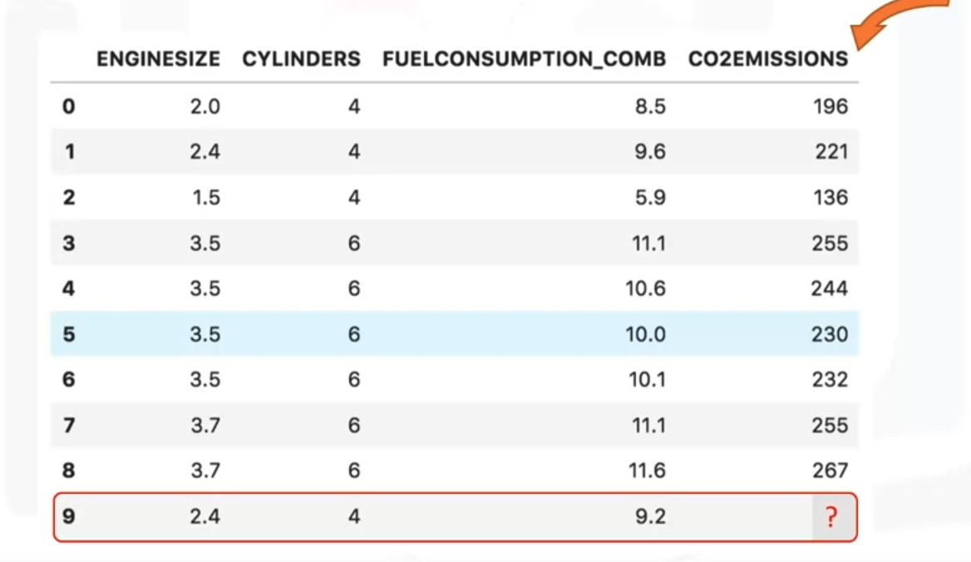
Regression
Regression is a process of predicting a continuous value

Slide 4
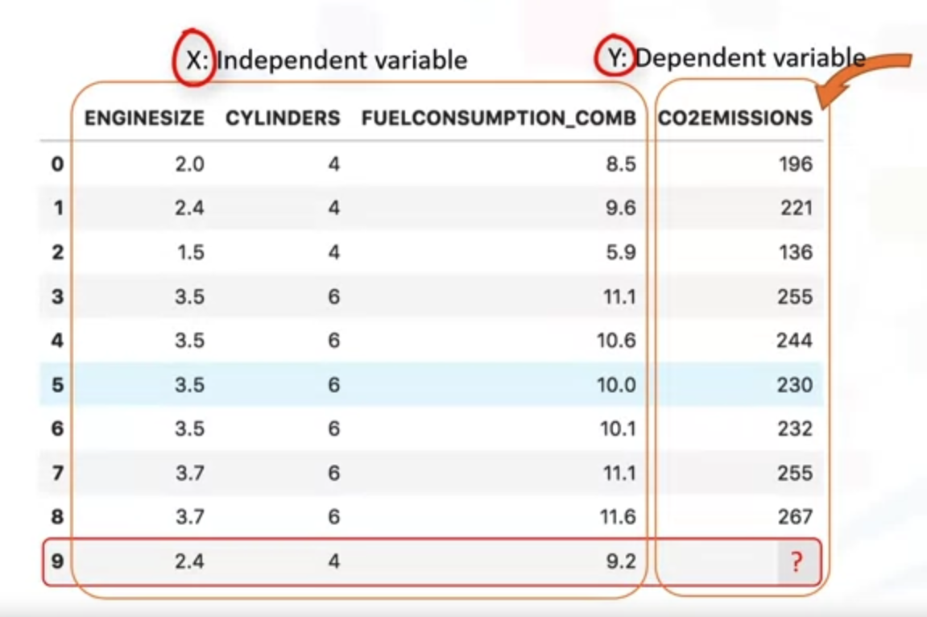
Regression
Dependent variable: the value we want to predict
Independent variables: the values that explain or cause the value of the dependent variable

Slide 5
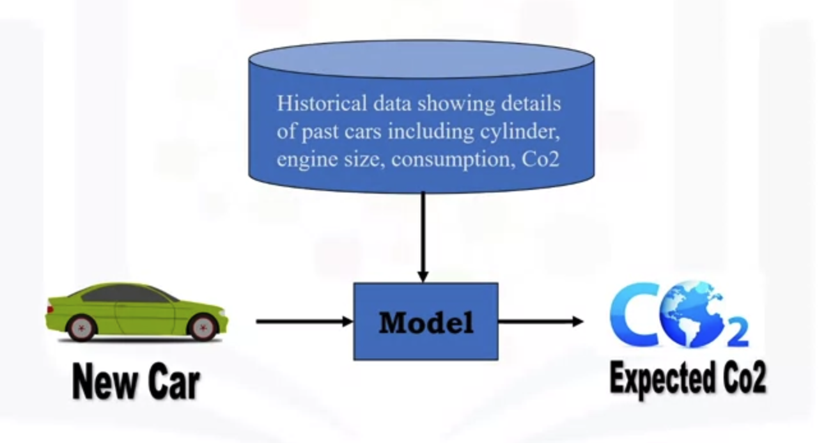
Regression

Slide 6
Types of regression
Simple Regression
Using one independent variable to predict the dependent variable
Ex: predict CO2 emssion using engine size.
Simple Linear Regression, Simple Non-Linear Regresison
Multiple Regression
Using more than one independent variables to predict the dependent variable
Ex: predict CO2 emssion using engine size and number of cylinders.
Mulitple Linear Regression, Multiple Non-Linear Regresison

Slide 7
Applications of regression
Sales forcasting
Predict a yearly sale of a person based on Age, Years of Experience, etc.
Satisfaction analysis
Detemine individual satisfaction based on demographic and psychological factors.
Price estimation
Predict a price of a house based on its size, number of rooms, etc.
Employment income
to predict employment income for independent variables such as hours of work, education, occupation, sex, age, years of experience

Slide 8

Quiz
Which one is a sample application of regression?
Predicting whether a patient has cancer or not.
Grouping of similar houses in an area.
Forecasting rainfall amount for next day.
Predicting if a team will win or not.

Slide 9
Some regresison algorithms
Ordinal Regression
Poisson Regression
Linear Regression
Polinomial Regression
Lasso Regression
Ridge Regression
Decision Forest Regression
Boosted Decision Tree Regression

Slide 10
Simple Linear Regresison

Slide 11
Simple Linear Regresison
Linear regression is the approximation of a linear model used to describe the relationship between two or more variables

Slide 12
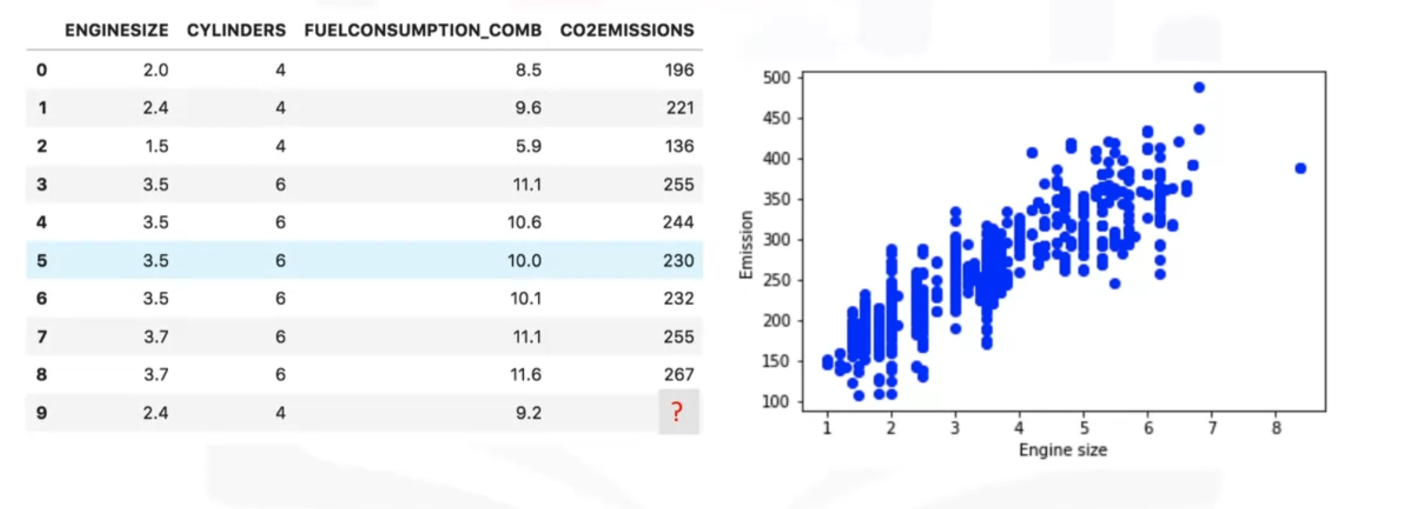
Simple Linear Regression
Changes in 1 variable explain changes in the other

Slide 13
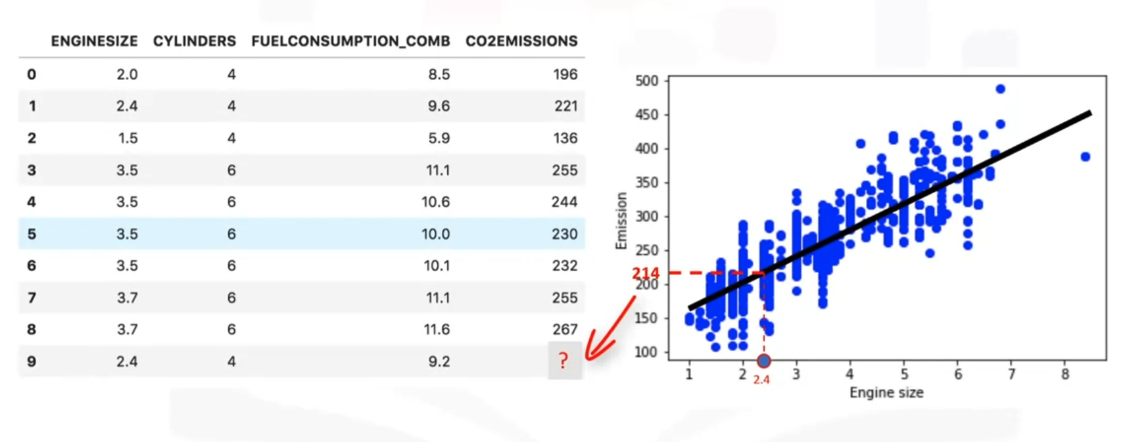
Simple Linear Regression

Slide 14
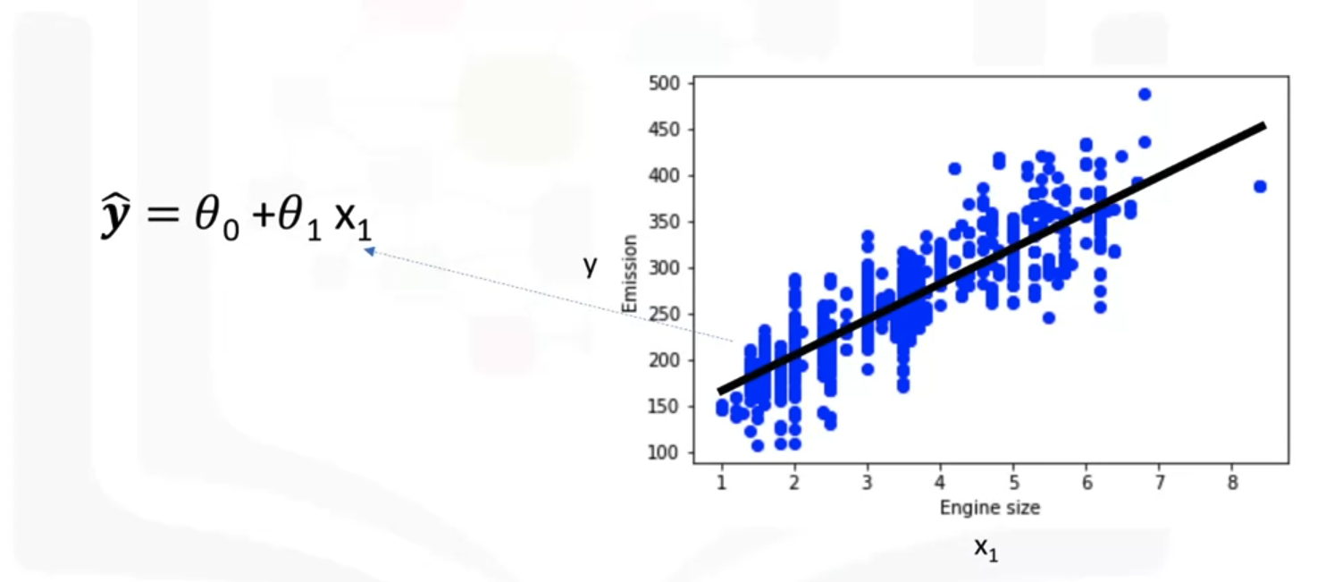
Simple Linear Regression
Parameters we need to find
Independent
variable
Independent
variable

Slide 15
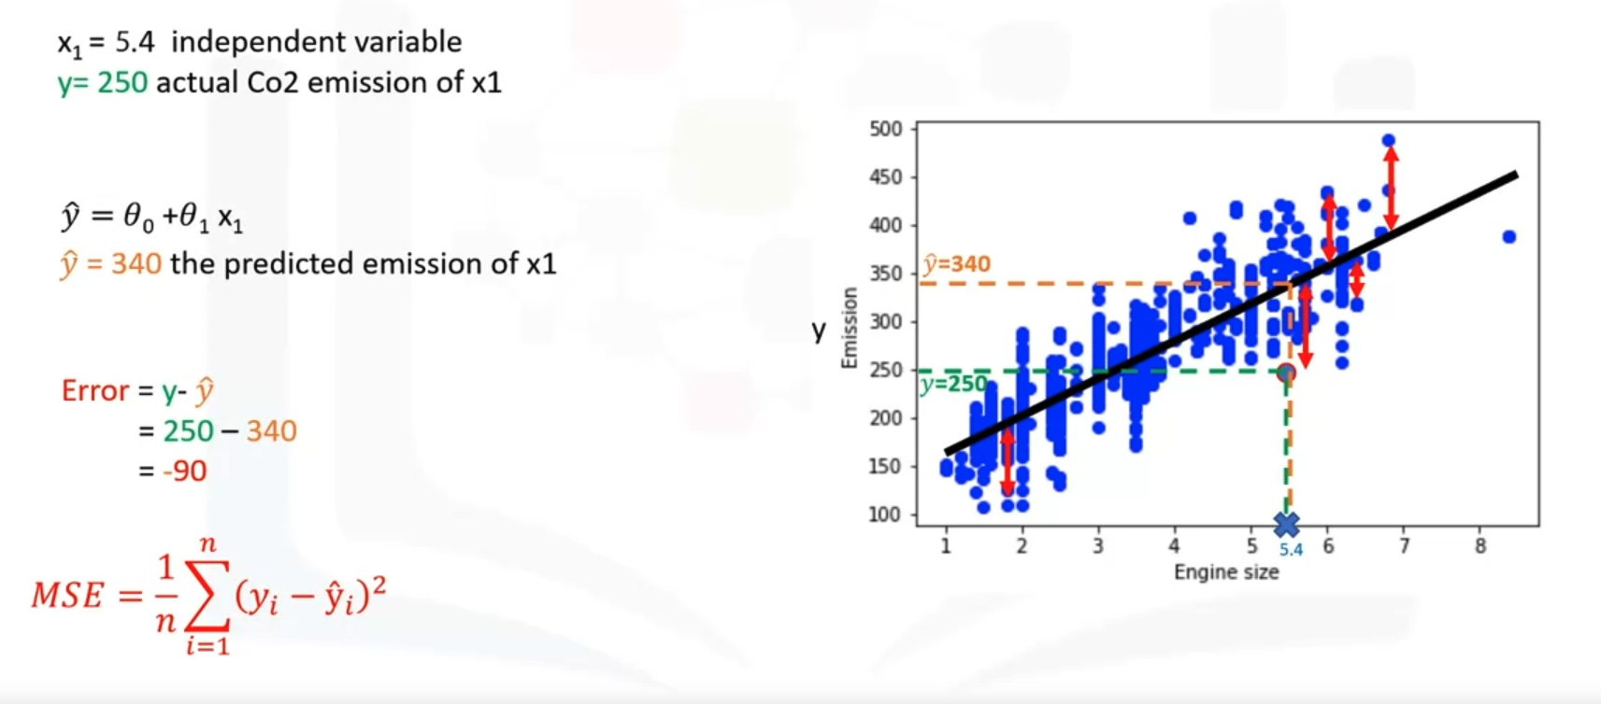
How to find the best fit?

Slide 16
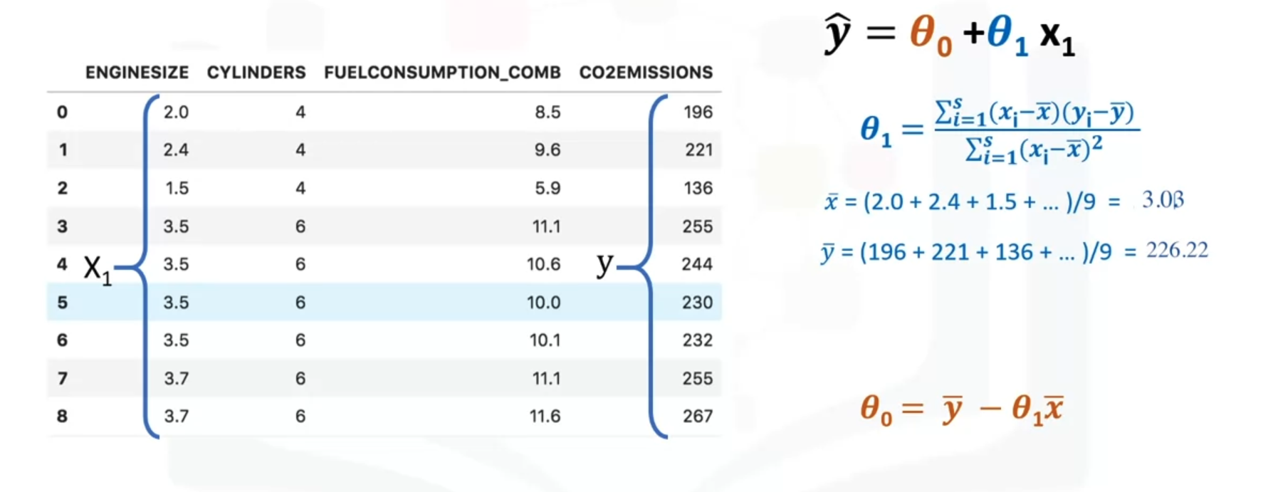
How to find the best fit? (Mathematic approach)
Minimizing the sum of squared errors (SSE)
Notes:
39, 125.74

Slide 17
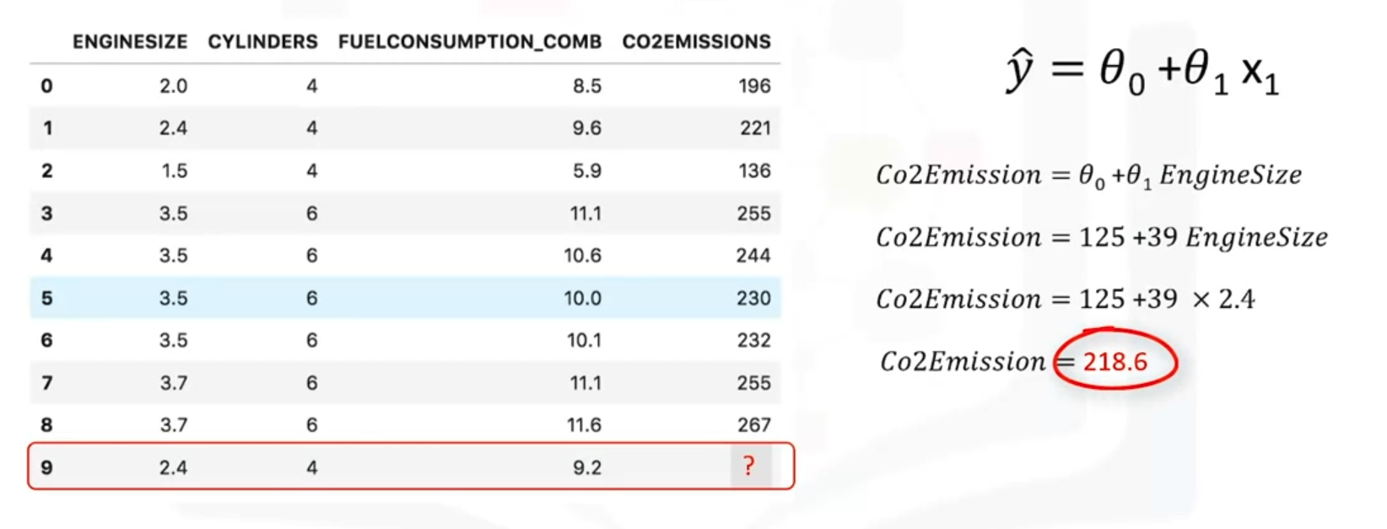
Prediction with simple linear regression

Slide 18
Disadvantages
No hyperparameters tuning
Very fast
Sensitive to outliers
Intepretable
Cannot handle non-linear relationships
Advantages

Slide 19
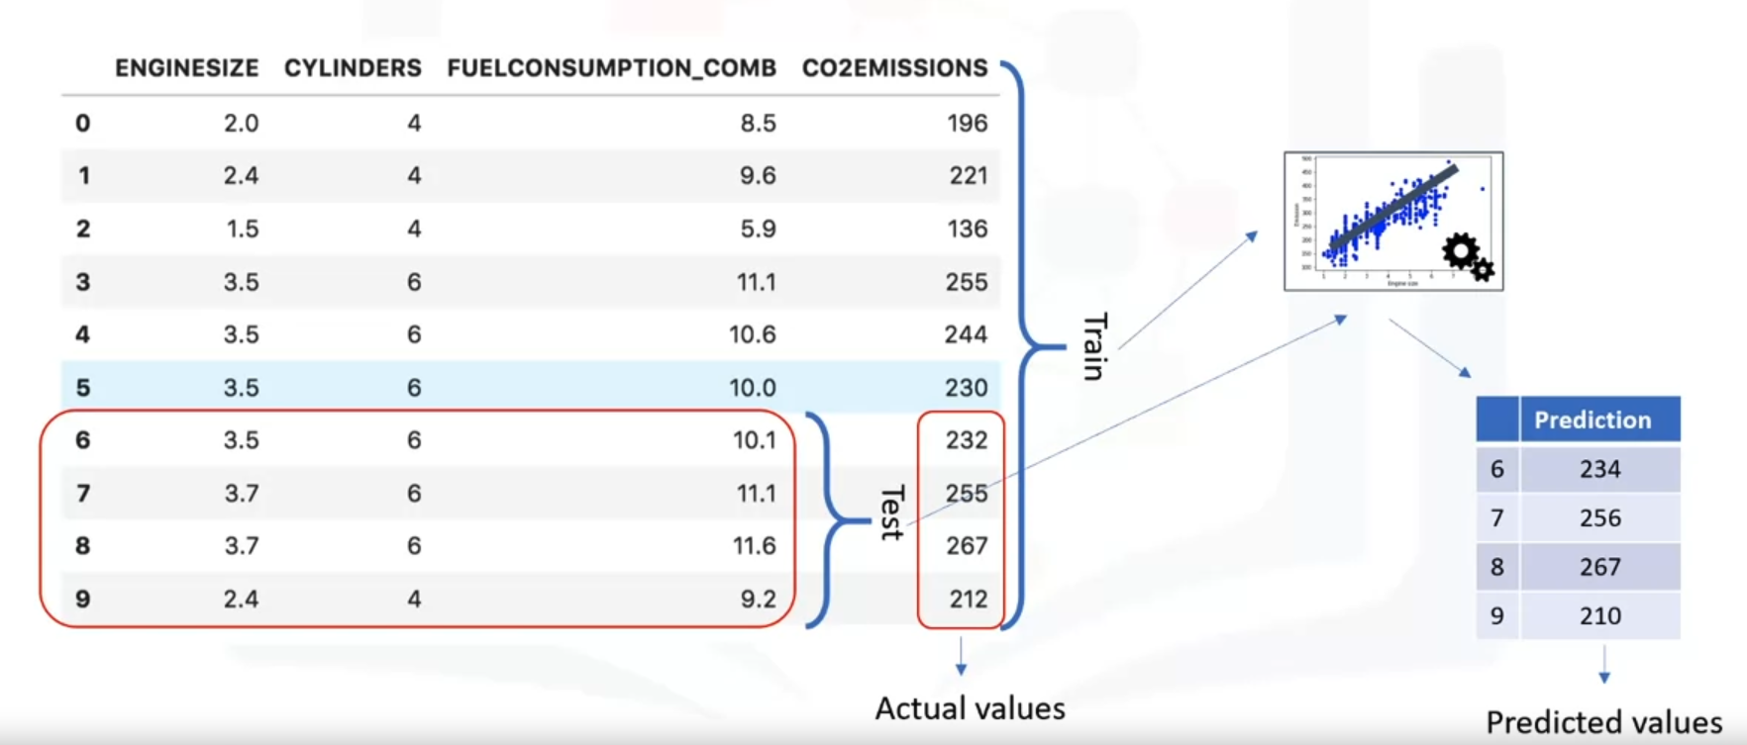
How to test the accuracy of the model
Train all data

Slide 20
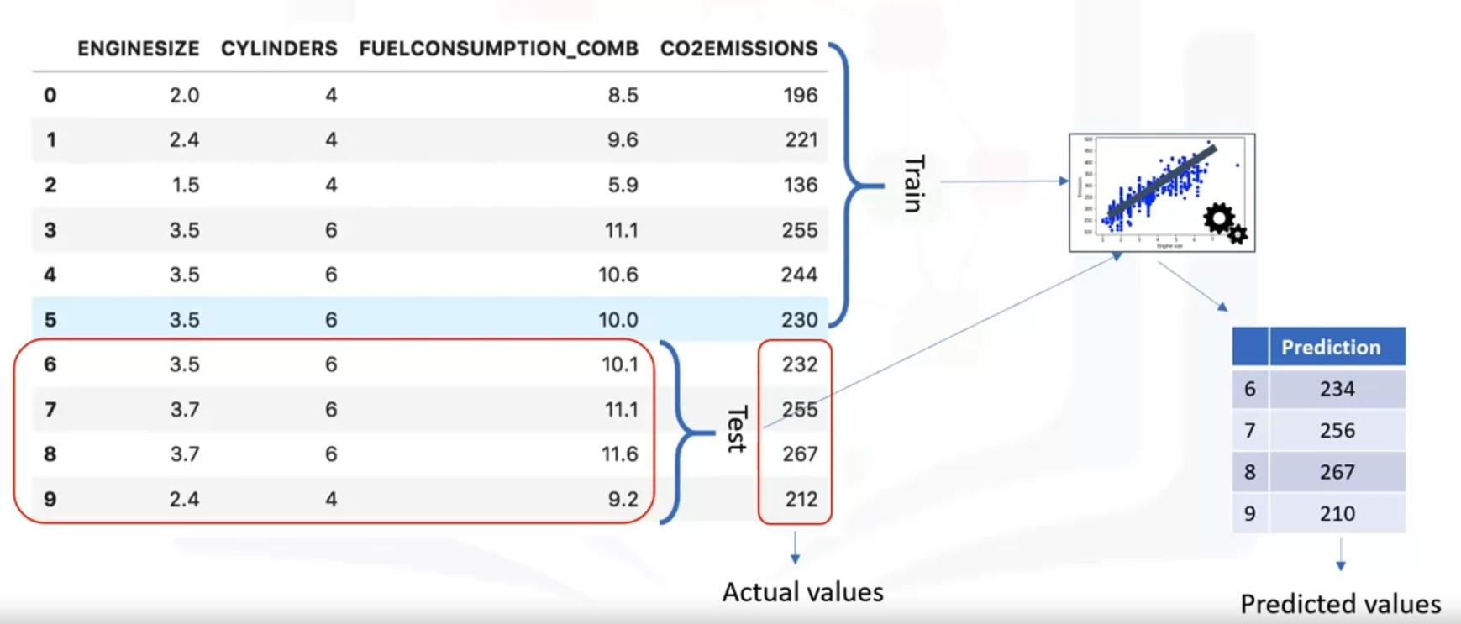
How to test the accuracy of the model
Train/Test split

Slide 21
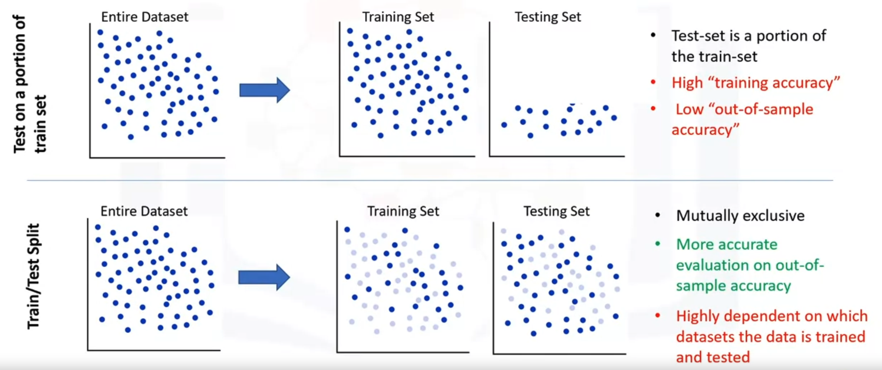
How to test the accuracy of the model
Train/Test split

Slide 22
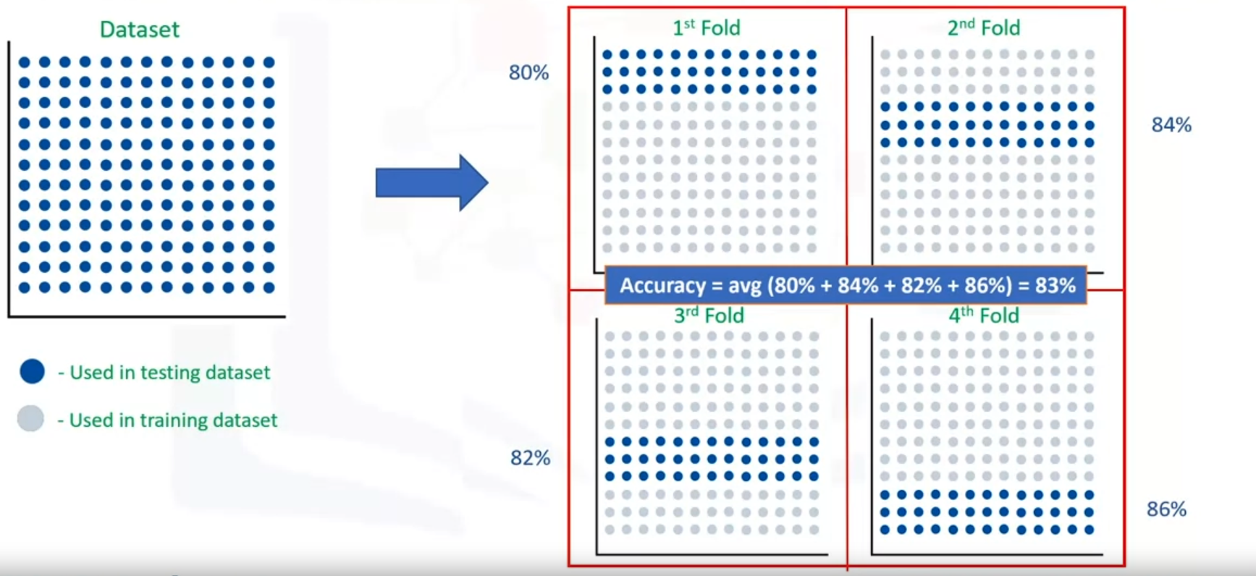
How to test the accuracy of the model
K-fold Cross Validation

Slide 23
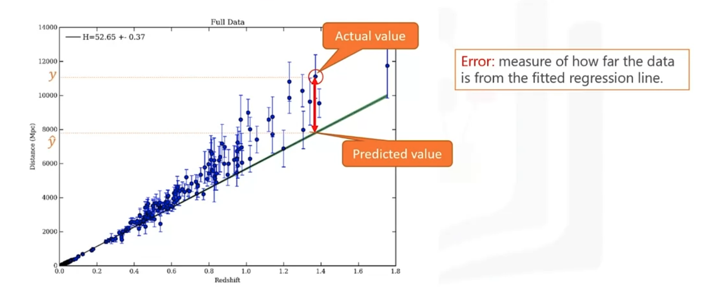
Evaluation Metrics in Regression Models
Error is the difference between the data points and the trend line generated by the algorithm

Slide 24
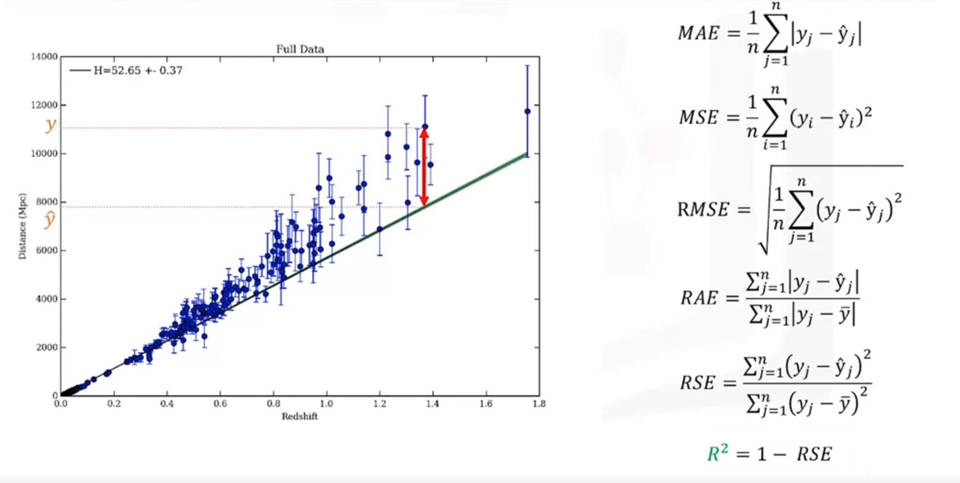
Evaluation Metrics in Regression Models

Slide 25
Multiple Linear Regression

Slide 26
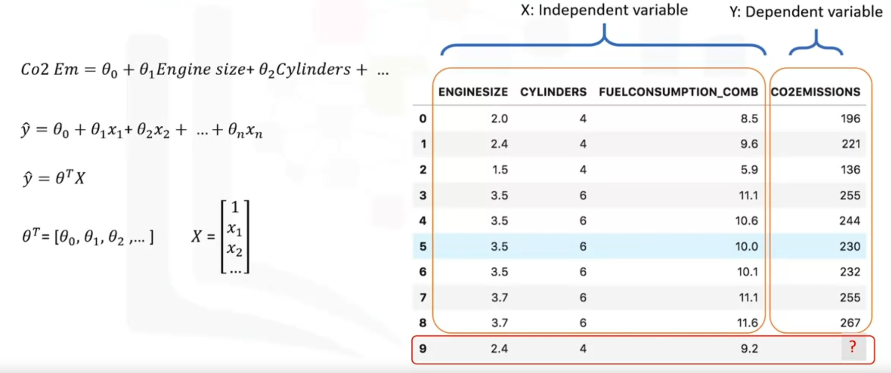
Multiple Linear Regression

Slide 27
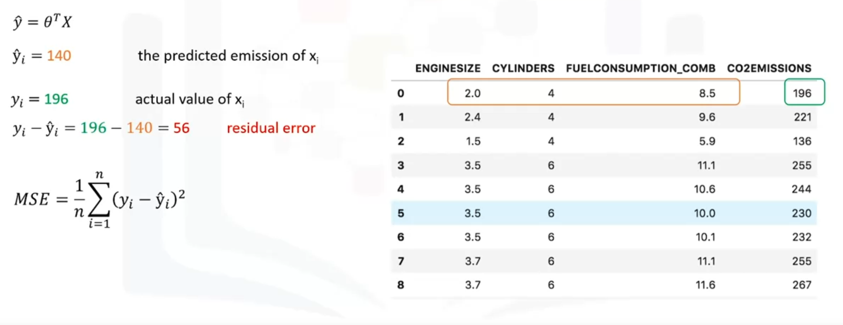
How to find best parameters for the Multiple Linear Regression?
Minimize

Slide 28
How to find best parameters for the Multiple Linear Regression?
Mathematical approach
Linear Algebra operation
For small dataset
Optimization approach
Gradient Descent
For large dataset

Slide 29
Graded Assignment
Using Linear Regression to predict house price for this dataset:
https://www.kaggle.com/datasets/prokshitha/home-value-insights
- Deadline: Monday, 25.11.2024

Slide 30
References
https://en.wikipedia.org/wiki/Linear_regression
https://machinelearningmastery.com/regression-metrics-for-machine-learning/
https://www.coursera.org/learn/machine-learning-with-python?specialization=ibm-data-science

